Slide 1




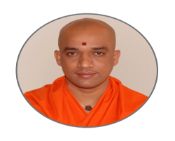

| | Jai Sri Gurudev || Sri AdichunchanagiriShikshana Trust ® SJB INSTITUTE OF TECHNOLOGY An Autonomous Institution under Visvesvaraya Technological University, Belagavi
BGS Health & Education City, Dr. Vishnuvardhan Road, Kengeri, Bengaluru - 560 060
Approved by AICTE, New Delhi, Accredited by NAAC, New Delhi with ‘A+’ Grade
Accredited by National Board of Accreditation, New Delhi
Recognized by UGC, New Delhi with 2(f) and 12(B), Certified by ISO 9001-2015
“A MINI PROJECT PRESENTATION ON CATERHUB”
SUBMITTED IN PARTIAL FULFILLMENT OF THE REQUIREMENTS FOR THE AWARD OF THE DEGREE OF
MASTER OF COMPUTER APPLICATIONS
His Divine Soul Jagadguru Padmabushana
Sri Sri Sri Dr. Balagangadharanatha
Maha Swamiji
Founder President
Sri Adichunchanagiri Shikshana Trust ®
His Holiness Jagadguru
Sri Sri Sri Dr. Nirmalanandanatha
Maha Swamiji
President
Sri Adichunchanagiri Shikshana Trust ®
Revered
Sri Sri Dr. Prakashanatha
Swamiji
Managing Director
BGS and SJB Group of Institutions

Slide 2

CATERHUB
A Web-Based Catering Service Platform
GUIDED BY,
NAME: Dr. VINAY K
DESIGNATION: ASSOCIATE PROFESSOR
DEPARTMENT: MCA
COLLEGE: SJB INSTITUTE OF TECHNOLOGY
PRESENTED BY,
NAME: DIVYA J, KAVYA S, & RACHANA R
USN: 1JB23MC010, 1JB23MC015, 1JB23MC035
DEPARTMENT: MCA
YEAR & SEM : 2nd YEAR, 3rd SEM
COLLEGE: SJB INSTITUTE OF TECHNOLOGY

Slide 3

TABLE OF CONTENTS
Introduction
Problem Statement & Need For Caterhub
Objectives of Caterhub
Literature Survey
Technology Stack & Architecture
ER Diagram & Flowchart
Frontend Screens – Page Walkthrough
Database Snapshots – MySQL Integration
Conclusion
Future Enhancement

Slide 4

INTRODUCTION
CaterHub is a web-based platform designed for managing catering services and event bookings.
It bridges the gap between customers and catering providers with a seamless digital experience.
Aims to eliminate traditional manual booking systems like phone calls or in-person visits.
Enhances customer interaction, booking convenience, and service visibility.
Offers a structured and user-friendly interface for all event planning needs.
Designed to make event catering simpler, smarter, and more accessible.

Slide 5
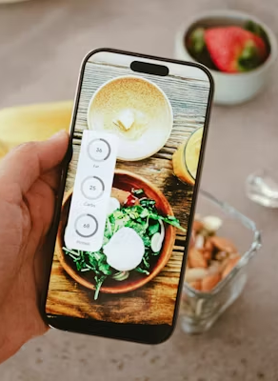
PROBLEM STATEMENT & NEED FOR CATERHUB
Challenges in the Catering Industry:
Limited online presence for many catering businesses.
Manual booking processes via calls or in-person visits cause delays.
No centralized system for managing customer bookings.
Lack of instant booking confirmation or records.
Poor user engagement due to outdated and non-responsive websites.
Need for a Platform like CaterHub:
Provides a dedicated online platform for booking catering services.
Allows users to select event types, menu preferences, and book easily.
Offers a user-friendly interface with smooth animations and design.
Customers can print an invoice after booking confirmation.
Reduces miscommunication by digitizing the booking process.

Slide 6

OBJECTIVES OF CATERHUB
To eliminate traditional, manual catering booking methods.
To provide a digital platform for seamless event booking and management.
To offer a secure login/signup system for user authentication.
To enable users to browse available services and submit booking requests online.
To deliver a modern, responsive, and user-friendly interface.
To ensure data privacy and security throughout the booking process.
To lay the foundation for future scalability and enhancements.

Slide 7



LITERATURE SURVEY
Similar Platforms in the Market:
EzCater: Focuses on corporate catering but lacks support for private events.
CaterCow: Offers transparent pricing but limited customization for events.
Fooda: Specializes in workplace catering; lacks interactive booking features.
Local Caterers' Websites: Often have poor UI/UX and limited functionality.
How CaterHub is Better:
Designed specifically for event-based bookings (weddings, parties, etc.).
Offers instant booking + invoice generation.
Features a modern and interactive UI/UX with animations.
Includes secure login/signup for better user control.
Built with scalability in mind for future enhancements.

Slide 8



TECHNOLOGY STACK AND ARCHITECTURE
⚙️ Technology Stack:
Frontend: React.js (with Vite)
Backend: Node.js with Express.js
Database: MySQL (Managed via MySQL Workbench)
API Communication: Axios
Animations: Framer Motion
Security: Helmet.js, CORS, Express Rate Limiting
🏗️ System Architecture Overview:
Client (Browser) interacts with the React.js frontend.
Frontend sends/receives data via Axios to the backend server.
Backend built with Node.js + Express.js handles routing, validation, and logic.
Backend communicates with MySQL database for storing bookings, users, and messages.
Security layers (Helmet, CORS, Rate Limiting) protect server and APIs.

Slide 9
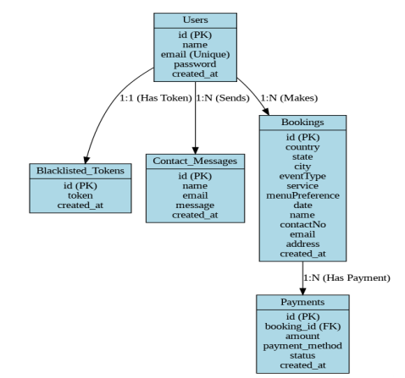
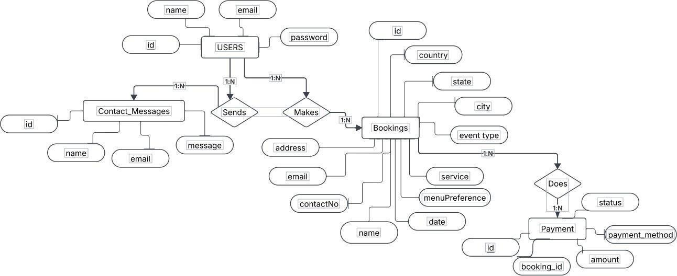
ER DIAGRAM AND FLOW CHART
FIGURE 1: ER DIAGRAM
FIGURE 2: FLOW CHART

Slide 10

FRONTEND SCREENS – PAGE WALKTHROUGH
Our CaterHub platform consists of multiple user-friendly pages, each designed with a clear purpose and elegant layout:
Login Page
Signup Page
Home Page
About Page
Services Page
Events Page
Menu Page
Contact Page
Booking Page
Payment Page
Payment Success Page

Slide 11
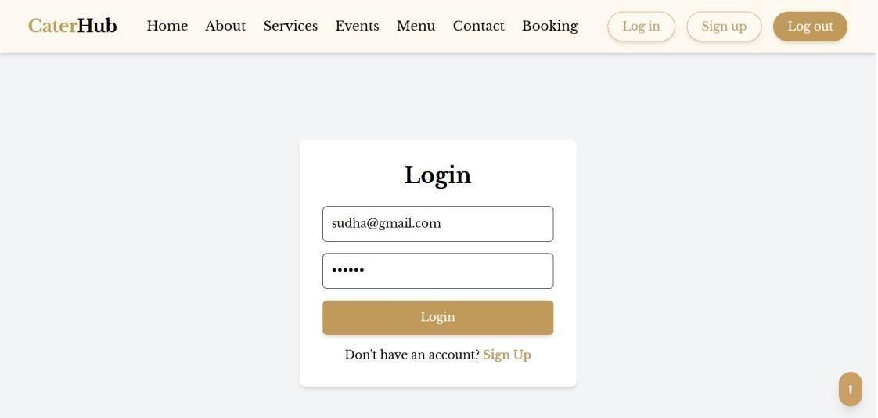
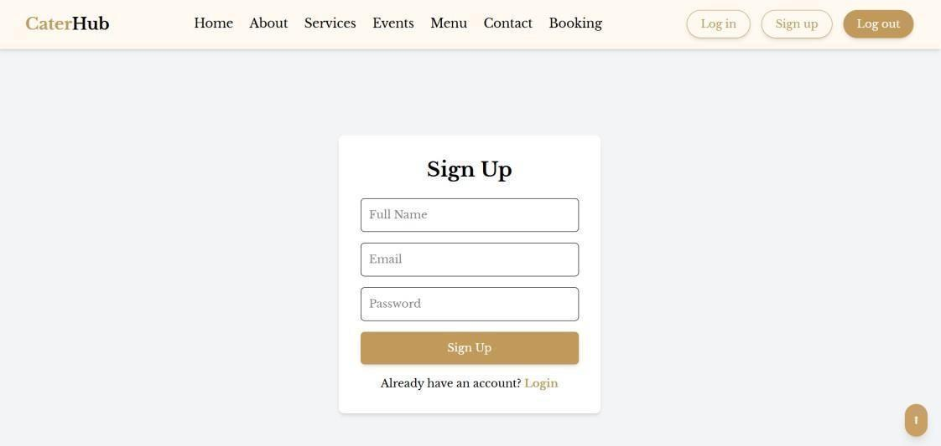
FRONTEND SCREENS – PAGE WALKTHROUGH
🔐 Login Page
A secure authentication module for registered users.
Validates input and provides real-time feedback messages.
Uses JWT for session-based access control.
On successful login, user is redirected to the homepage.
📝 Signup Page
Allows new users to create an account.
Implements form validation and error handling.
Styled with smooth Framer Motion animations.
Collects user name, email, and password for registration.

Slide 12
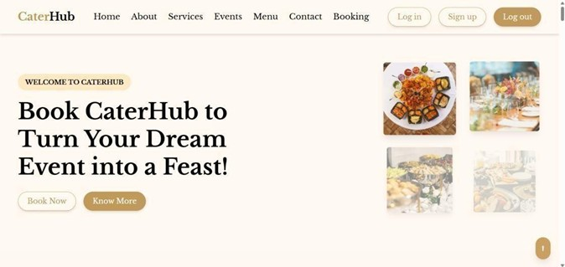
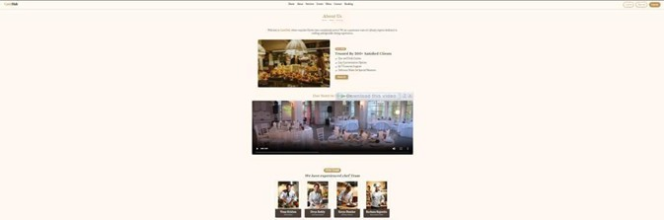
FRONTEND SCREENS – PAGE WALKTHROUGH
🏡 Home Page
Features a dynamic hero section with typewriter text animation.
Includes floating food images and engaging visuals.
Contains Call-to-Action (CTA) buttons: “Book Now” and “Know More.”
Designed using Framer Motion for smooth entrance effects and animations.
👩‍🍳 About Page
Highlights the journey and values of CaterHub.
Includes an engaging “Our Story” section and client trust highlights.
Contains a team showcase of chefs and professionals.
Framer Motion animations enhance the storytelling experience.

Slide 13
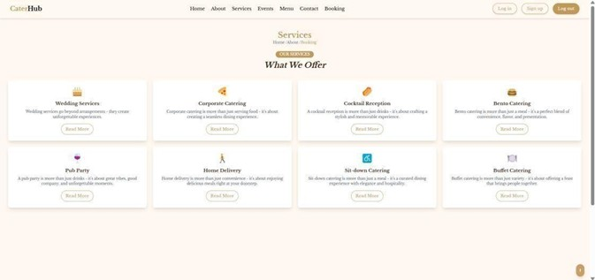
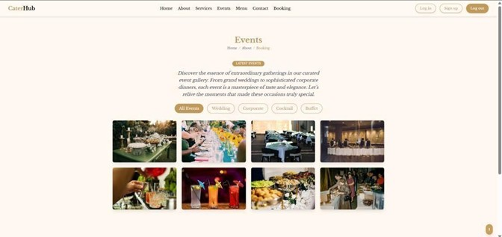
FRONTEND SCREENS – PAGE WALKTHROUGH
🛎️ Services Page
Displays various catering services offered by CaterHub.
Visually engaging layout using icons and content blocks.
Includes hover effects and smooth animations for interactivity.
The content is read-only — it’s for displaying available services only.
🎉 Events Page
Showcases categories of events like Weddings, Corporate, Cocktail, Buffet, etc.
Includes a dynamic gallery with category filters.
Hover effects and animations create a lively browsing experience.
It is a display-only page, not linked to booking directly.

Slide 14
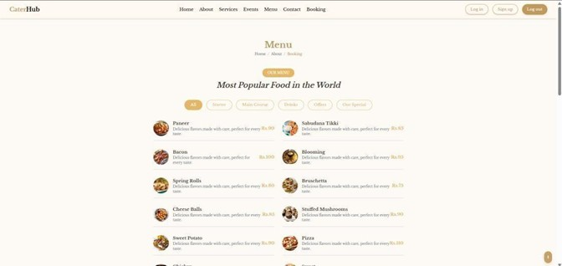
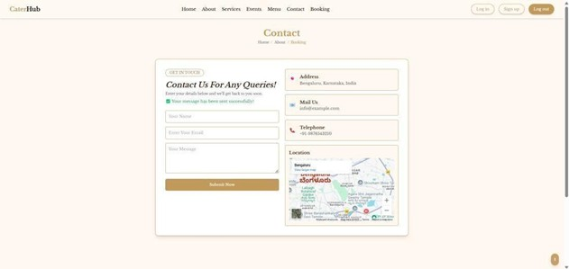
FRONTEND SCREENS – PAGE WALKTHROUGH
🍲 Menu Page
Provides a visually rich display of menu options.
Categorized menus shown with appealing food images.
Fully responsive layout for mobile and desktop users.
The page is read-only and is used only to display the available menu options.
📬 Contact Page
Includes a clean contact form for user queries and feedback.
Fields: Name, Email, Message – with validation.
Styled using Framer Motion animations for input and button elements.
Contact details and an embedded Google Map are provided for user convenience.

Slide 15
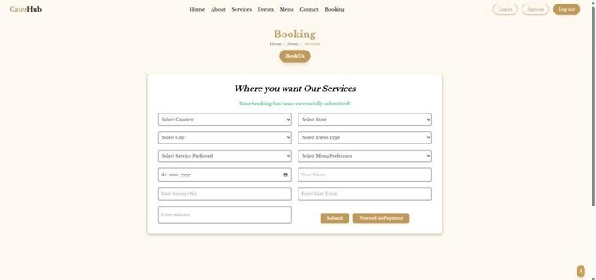
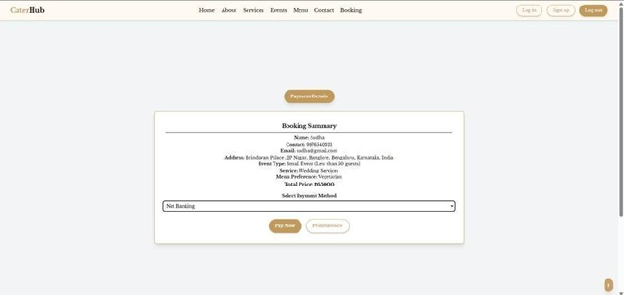
FRONTEND SCREENS – PAGE WALKTHROUGH
📝 Booking Page
Users can schedule catering services by filling out a detailed booking form.
Fields include: Event Type, Service Preference, Menu, Location, Contact Info, Date.
Form supports real-time validation for inputs like name, email, phone number.
Dropdowns dynamically update state and city based on selected country.
A "Proceed to Payment" button redirects users to the payment page.
💰 Payment Page
Fetches the most recent booking details dynamically.
Calculates the total price based on selected services.
Offers multiple payment method options.
On successful payment, an invoice is generated for the user.

Slide 16
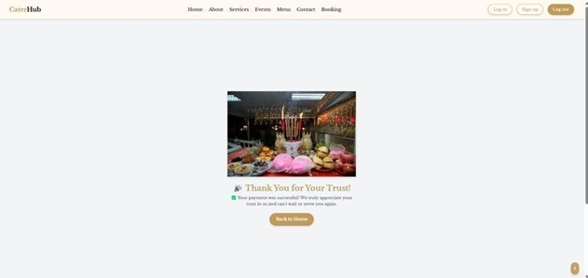
FRONTEND SCREENS – PAGE WALKTHROUGH
🎉 Payment Success Page
Confirms the successful transaction with a clean and visually appealing message.
Includes smooth Framer Motion animations for UI elements.
Displays booking confirmation and optional invoice download.
Final step in the booking flow — reassures the user everything is completed.

Slide 17
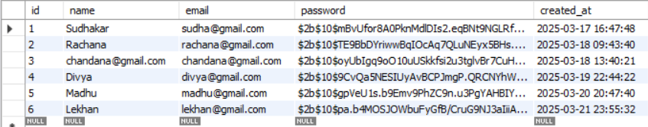
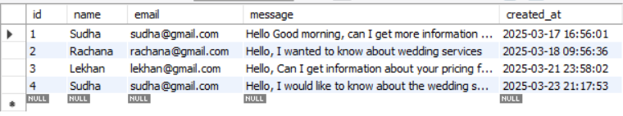
DATABASE SNAPSHOTS – MYSQL INTEGRATION
User Data Storage Snapshot
User Inquiries Storage Snapshot

Slide 18
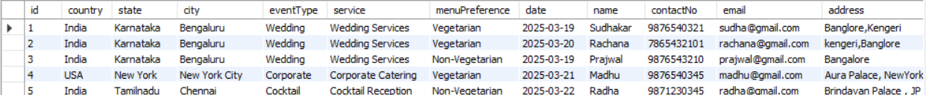
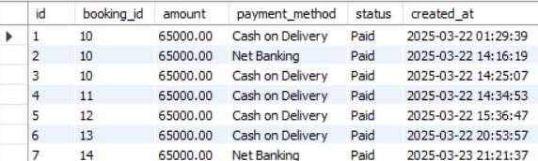
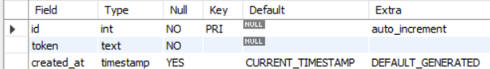
DATABASE SNAPSHOTS – MYSQL INTEGRATION
Booking Data Snapshot
Payment Records Snapshot
JWT Blacklist Storage Snapshot

Slide 19
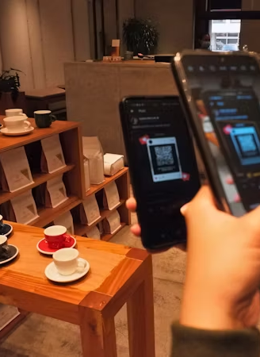
FUTURE ENHANCEMENTS
Integrate a Collaboration Hub for service providers and customers.
Enable real-time chat support for faster communication.
Add AI-powered menu suggestions based on event type.
Introduce multi-language support for better accessibility.
Expand platform to support multiple vendor bookings.

Slide 20

CONCLUSION
CaterHub provides a simple and efficient platform for catering service bookings.
Reduces manual effort and streamlines the entire booking process.
Improves customer experience with a clean and accessible interface.
Offers a centralized system for event planning and booking.
Lays the foundation for future upgrades and integrations.

Slide 21
BIBILOGRAPHY
[1] S. Patel and A. Gupta, “Enhancing E-Commerce Platforms with React.js and Tailwind CSS for Optimal User Experience,” Journal of Computer Science & Engineering, vol. 20, no. 4,pp.210–225, 2022.
[2] R. K. Sharma, T. Verma, and M. Das, “Security Considerations in Web Applications: Implementing JWT and Bcrypt,” Cybersecurity and Web Technologies Journal, vol. 18, no. 3, pp. 134–150, 2021.
[3] L. Fernandez and J. Brown, “Scalable Web Development Using Node.js and Express.js,” Journal of Software Engineering and Applications, vol. 12, no. 6, pp. 89–105, 2020.
[4] React.js Documentation – https://react.dev
[5] Tailwind CSS – https://tailwindcss.com/docs
[6] Framer Motion – https://www.framer.com/motion
[7] Node.js & Express – https://nodejs.org, https://expressjs.com
[8] MySQL Workbench – https://dev.mysql.com
[9] W3Schools – https://www.w3schools.com
[10] MDN Web Docs – https://developer.mozilla.org
[11] Stack Overflow – https://stackoverflow.com
[12] GitHub Discussions – https://github.com/discussions
[13] CaterServ Template – https://themewagon.github.io/CaterServ
[14] YouTube Tutorials – https://www.youtube.com

Slide 22

🙏 Thank You!
We appreciate your time and attention. 🎤 Any Questions? We’re happy to answer!

